Slide 1
GREEN GRID AFRICA

Slide 2
The Challenge in Off-Grid Energyp(p p
Unreliable and inefficient solar power distribution in off-grid communities due to poor monitoring and lack of predictive maintenance.

Slide 3
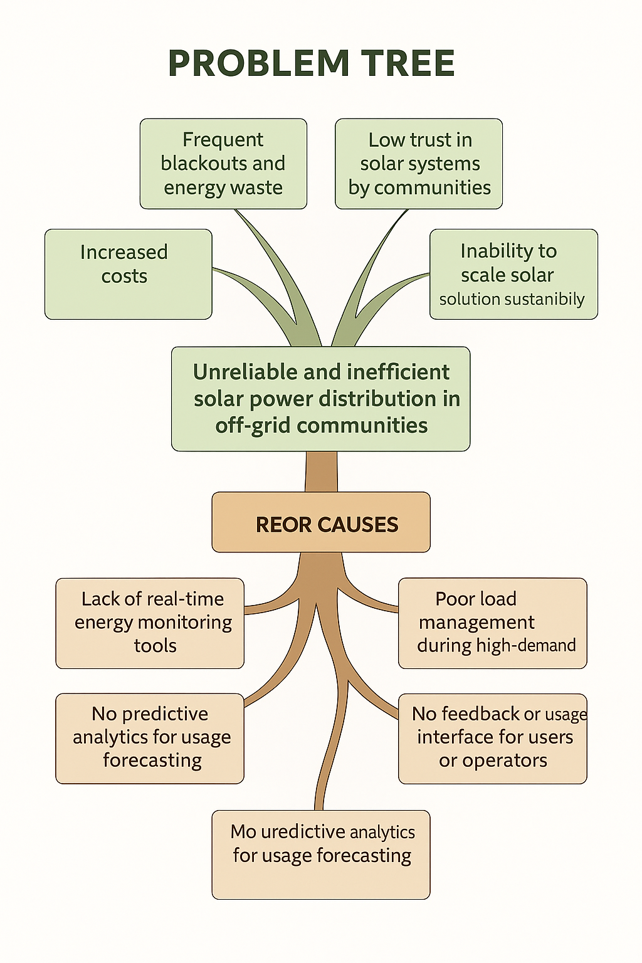
OUR CORE PROBLEM ROOTS AND EFFECTS!
ROOT CAUSES
Lack of predictive maintainance of the system

Slide 4
1. Our Smart Energy Solution
Idea: An IoT system powered by AI to optimize solar mini-grid operations, forecast energy usage and demand, and automate smart maintenance.

Slide 5

Big concept
Imagine a rural village where power doesn’t flicker, batteries don’t die, and energy doesn’t go to waste...that’s what we envision in our plan.
Green Grid Africa uses AI + IoT to transform ordinary solar mini-grids into intelligent energy systems — systems that learn, predict, and respond to real community needs.
We're making it reliable, affordable, and sustainable.

Slide 6

Evaluation Criteria For Proposed Solutions
criteria | Score | Justification
Novelty | 5 | Idea is largely untapped locally.
Impact | 5 | Reduces blackouts, saves costs, and improves energy reliability in rural areas.
Feasibility | 4 | Team has Skills, uses affordable hardware and open source platforms.
Scalability | 4 | Scalable locally and can expand to multiple locations.
User Need fit | 5 | Directly solves a pressing problem for mini-grid operators and rural residents.

Slide 7
Our Clean Energy Innovation Strategy Score.
Key Factors | Diesel Generators | Standard Solar Systems | Green Grid Africa (Our Innovation)
Affordability Over Time | Medium (fuel costs) | High | ✅ Very High (AI optimization)
Energy Reliability | Low | Medium | ✅ Very High (predictive control)
Smart Monitoring & Analytics | ❌ None | ❌ Limited | ✅ Advanced AI & IoT system
Environmental Impact | ❌ High emissions | Low | ✅ Minimal (green & efficient)
Scalability | Medium (fuel/logistics) | Medium | ✅ High (cloud-based, modular)
Maintenance Prediction | ❌ Reactive | ❌ Manual | ✅ Predictive via AI alerts
User Engagement Interface | ❌ None | ❌ Minimal | ✅ Simple community dashboards

Slide 8
Which People do we aim to Reach?
Solar Mini-Grid Operators – Monitor production/consumption and plan maintenance
Community Members – Reliable power and feedback via user-friendly dashboards.
We have identified a solar mini grid in Olderkesi, Narok county as our target area.

Slide 9
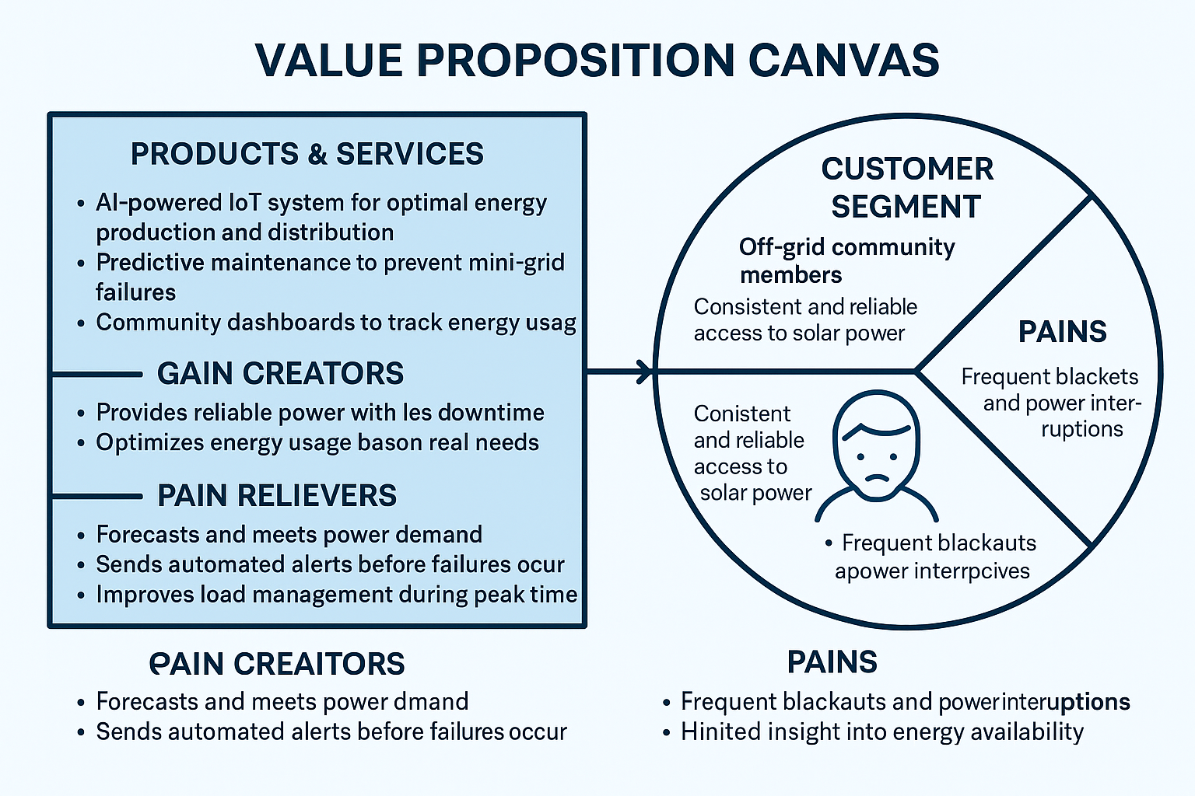
What We Offer and Why It matters!
blackouts

Slide 10
The Tech we Need !!!!!
Canvas Block | Details
Tech Components | AI-powered IoT system, ESP32, cloud-based analytics dashboard
Tools & APIs | FIWARE, Python, Node-RED, OpenAI/ML APIs
Data Sources | Local sensor data (solar output, battery levels, consumption logs)
Skill Readiness | Team has AI, software, hardware, and UI/UX experts
Prototype Timeframe | MVP possible in 8–12 weeks

Slide 11

FEASIBILITY CANVAS – BIZ FIT
Canvas Block | Details
Cost Structure | ESP32 sensors, solar grid integration, hosting costs
Revenue Model | NGO/Govt. partnerships, grid subscriptions, data insights licensing
Value Proposition | Reliable, efficient, affordable solar power for off-grid communities
Competitive Advantage | Localized AI + IoT approach, modular setup, open-source tools
Scalability Potential | High – replicable with minimal hardware changes

Slide 12
FEASIBILITY CANVAS – USER FIT
CANVAS BLOCK | DETAILS
Target Users | Mini-grid operators and off-grid community members
Key Pains | Frequent blackouts, lack of monitoring, poor load planning
User Gains | Consistent energy, transparency, proactive maintenance
Usability Plan | Simple dashboards, mobile alerts, community training
Adoption Readiness | Validated need; system designed with user feedback

Slide 13
MUST HAVE SKILLS !!!!!
Category | Tool/Platform | Purpose
Hardware Prototyping | ESP32 + Sensors | Collect solar energy data, consumption metrics
 | Arduino IDE | Programming the ESP32 microcontroller
 | Tinkercad (Simulated), Wokwi | Circuit simulation for early-stage design
Backend/API | Node-RED | Visual logic, API integration for sensor and AI input
 | FIWARE | Open-source platform for smart systems data processing
 | Supabase | Data storage for energy usage, system logs
AI/ML Integration | Google ML Kit | Forecasting energy demand, anomaly detection
 | OpenAI | Predictive analytics and load balancing
Frontend/UI | React.js | Build community dashboards and mobile interfaces
Visualization Tools | Grafana / Chart.js | Display real-time energy stats and load curves
Deployment | JHUB | Host web services and dashboards during MVP phase

Slide 14
ALIGNMENT WITH GLOBAL GOALS
UN SDG 7
Affordable and Clean Energy
Industry, Innovation and Infrastructure.
UN SDG 11
UN SDG 9
Sustainable Cities and Communities

Slide 15
Innovation begins where scarcity meets purpose — Green Grid Africa was born from the need to light up communities, not just homes”

Slide 16
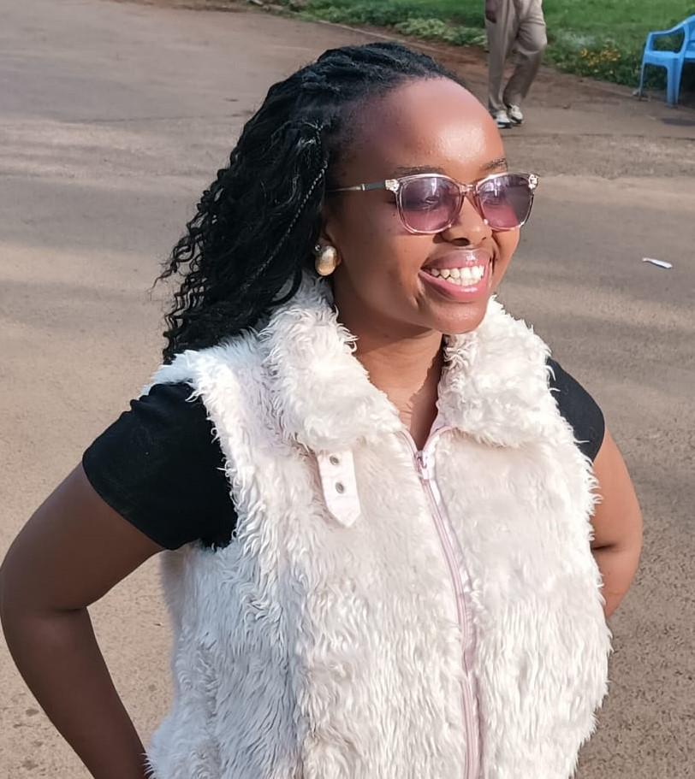
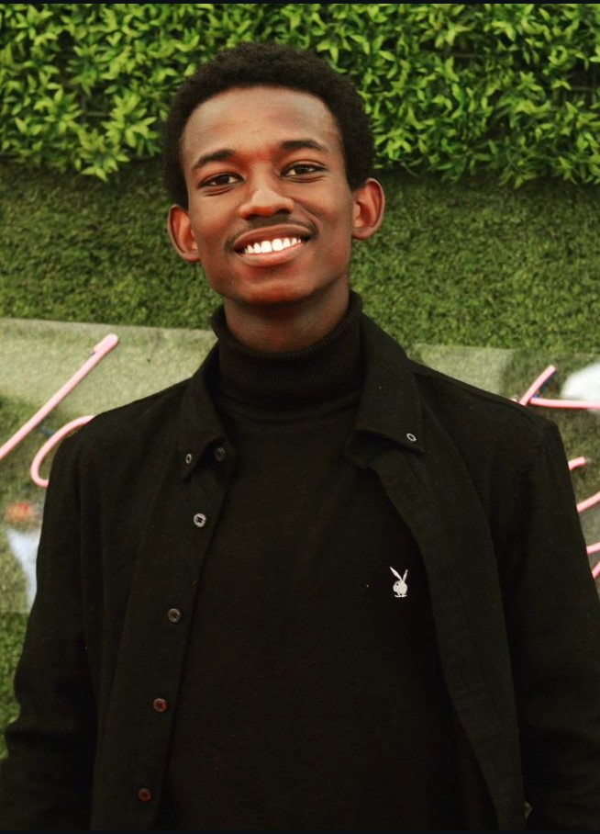
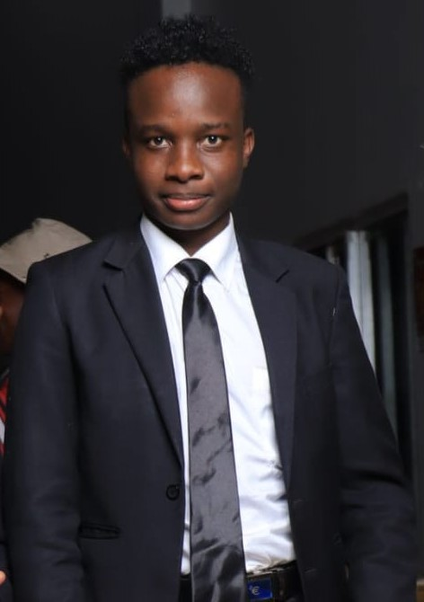
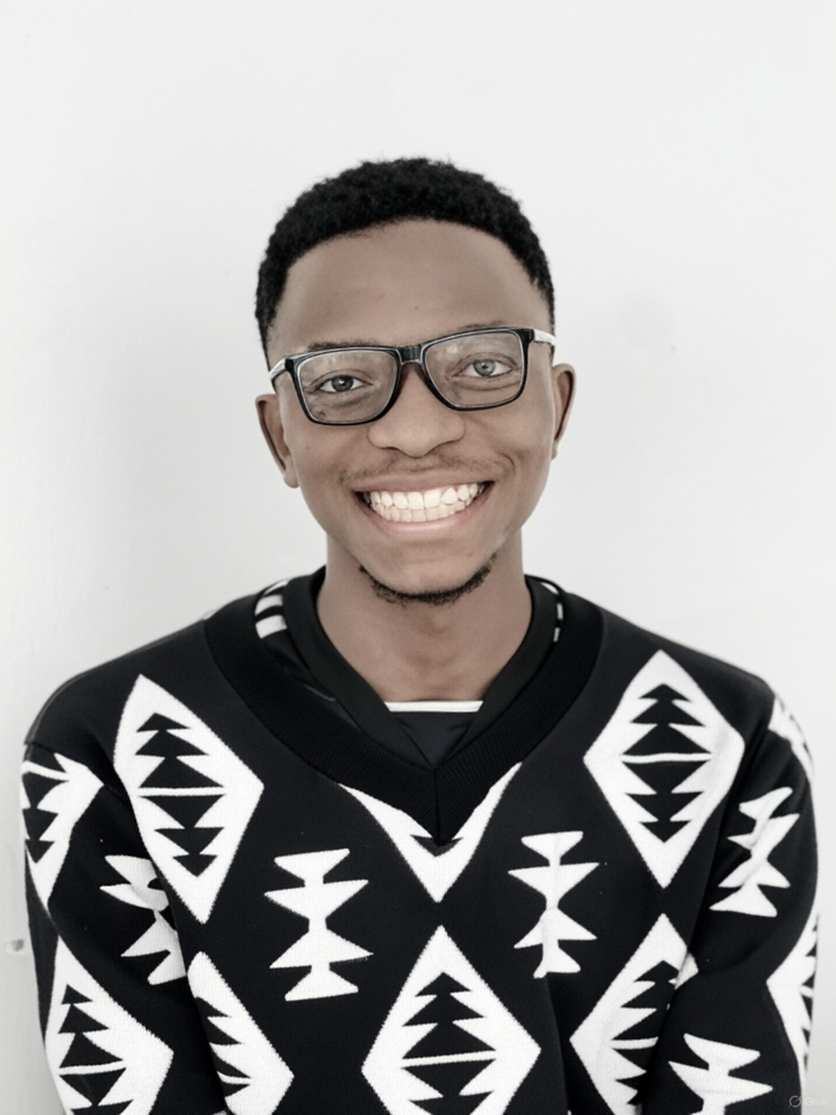
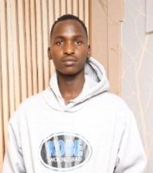
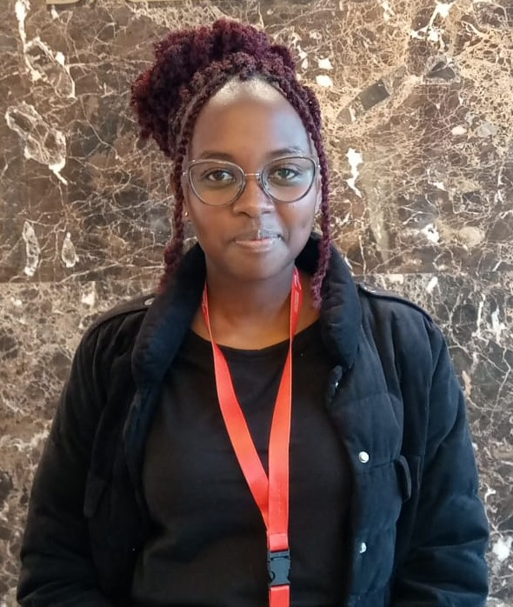
OUR TEAM!
MICHELLE MWANGI PROJECT LEAD & BACKEND DEVELOPER
BENEDICT MUTUA IoT ENGINEER
JAHONGA SHELDON UI/UX DEVELOPER
JOHN NYONGESA DATA ANALYST
BRIAN KIPKEMBOI AI/ML SPECIALIST
JOY BIWOTT FIWARE INTEGRATER

Slide 17
Thank You ❤!
Any questions?

